Slide 1
CI/CD Pipeline for Student Portfolio Website
USING AWS CODEPIPELINE, CODEBUILD AND CODEDEPLOY
PRESENTED BY :
Y.VENI VANDHANA
D.PAVANI SURYA KUMARI
M.SANJANA
M.TENNY SAMUEL SWARAJ
U.KOUSALYA

Slide 2
AGENDA
Project Overview
What is Ci/Cd
CI/CD Workflow
Pipeline Process
AWS services used
Project Architecture
CI/CD pipeline and screenshot
Output screenshot
Benefits
Conclusion

Slide 3
PROJECT OVERVIEW Project: Student Portfolio Website Technologies Used:
HTML
CSS
JAVASCRIPT
GITHUB
AWS CODEPIPELINE
AWS CODEBUILD
AWS CODEDEPLOY
AMAZON EC2

Slide 4
What is CI/CD
Continuous integration & continuous deployment
It is a modern software development practice that automates the process of building, testing and releasing code. By eliminating manual tasks and caching bugs early, it allows development to ship updates faster and more reliably
BEFORE CI/CD:
Manual deployment
Time consuming
Human errors
AFTER CI/CD:
Automated deployment
Faster updates
Reliable and Scalable

Slide 5
CI/CD WORKFLOW:
Developer
GitHub Repository
AWS CodePipeline
AWS CodeBuild (Build Website)
AWS CodeDeploy
Amazon EC2 (Student Portfolio Website)

Slide 6
PIPELINE PROCESS:
Developer updates the portfolio website.
Code is pushed to GitHub.
CodePipeline detects the new commit.
CodeBuild validates the project and creates the build artifact.
CodeDeploy deploys the latest version to the EC2 instance.
The updated portfolio website is available to users.

Slide 7
AWS SERVICES USED:
AWS SERVICE | PURPOSE
GitHub | Source code repository
AWS codePipeline | Automates the CI/CD workflow
AWS CodeBuild | Build and validates the website
AWS CodeDeploy | Deploys the website to EC2
Amazon EC2 | Hosts a portfolio website
Auto scaling | Extends multiple servers when needed
Load balancer | Traffic distribution

Slide 8
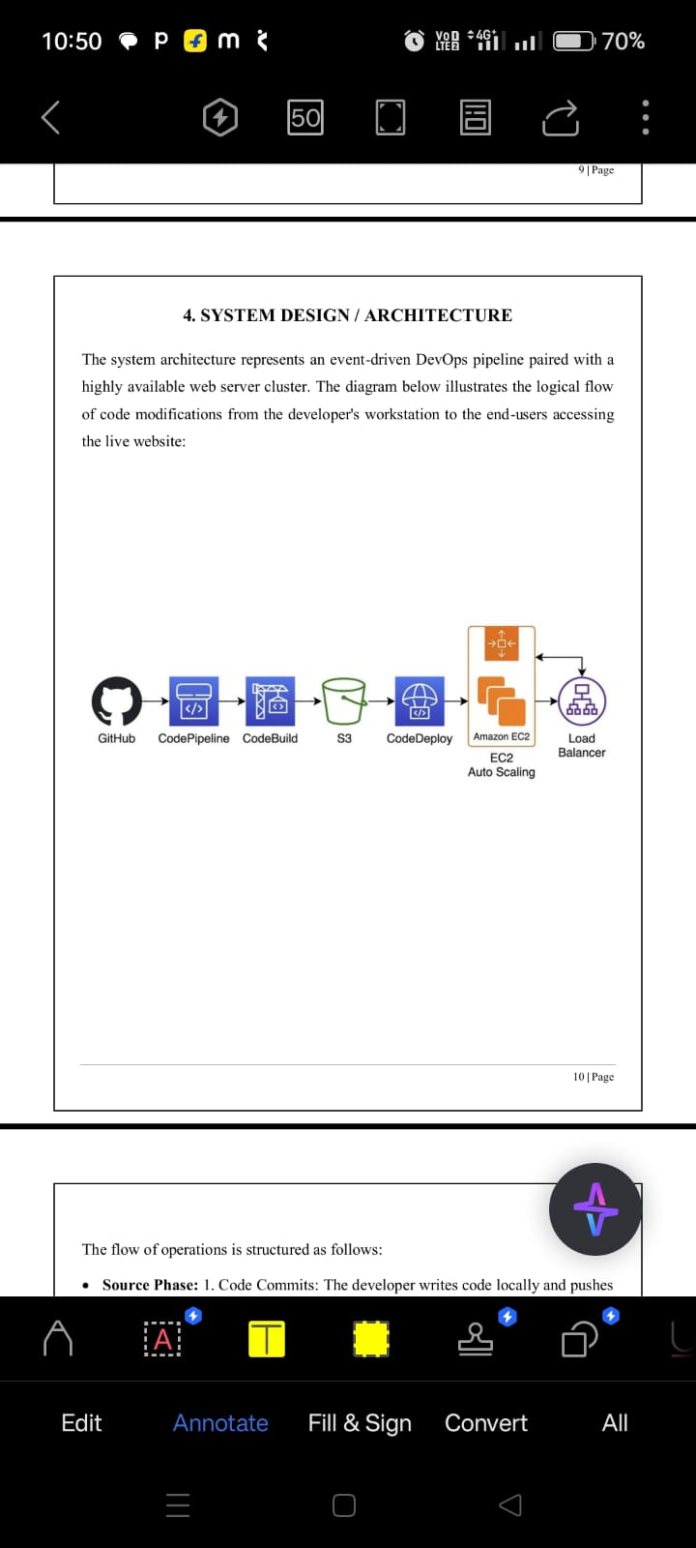
PROJECT ARCHITECTURE:
The diagram below illustrates the logical flow of code modifications from the developers workstation to the end-users accessing the live website.

Slide 9
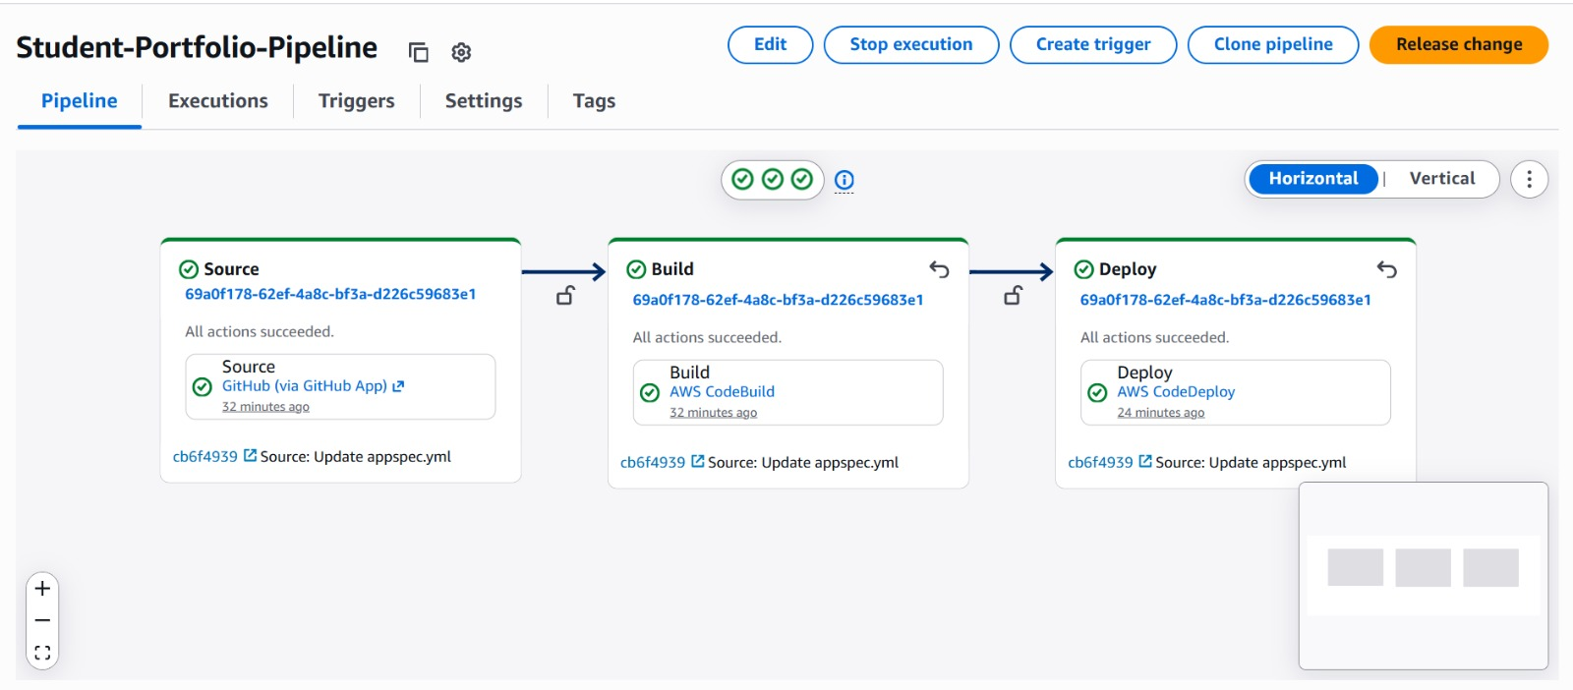
CI/CD Pipeline and Screenshot

Slide 10
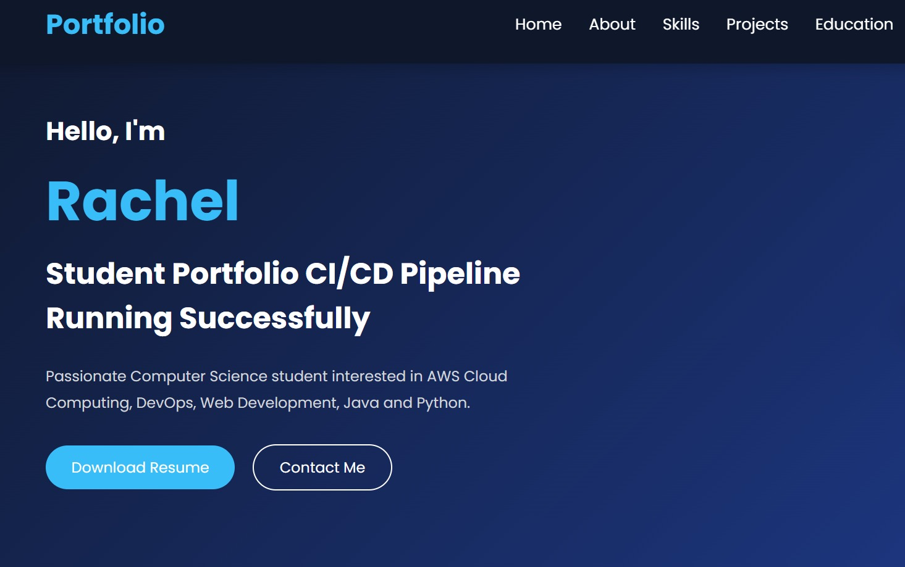
OUTPUT SCREENSHOT:
Portfolio website opened using the link below
https://student-alb-979743582.eu-north-1.elb.amazonaws.com

Slide 11
BENEFITS
Fully automated deployments.
Faster software releases.
Reduced deployment errors
Easy roll back.
Improved collaboration.
Scalable and secure.

Slide 12
CONCLUSION
Outcome:
Ci/cd pipeline successfully implemented.
Fully automated deployment pipeline.
Website hosted on AWS.
High availability.
Easy maintenance and scalability using AWS DEVOPS service.

Slide 13
THANK YOU

